Slide 1

Project Presentation
Regulated BOOST Converter
Course Name: Analog Integrated Circuit Laboratory Group No: 06
Course No: EEE466
Submitted By:
Name:
Voktho Das
Md Rasel Mia
Deb Indronil Sajib
Monirul Islam
STD ID:
1706022
1706023
1706041
1706042
Submitted To:
Dr. A.B.M. Harun-ur-Rashid
Saleh Omar
Nafis Sadik

Slide 2
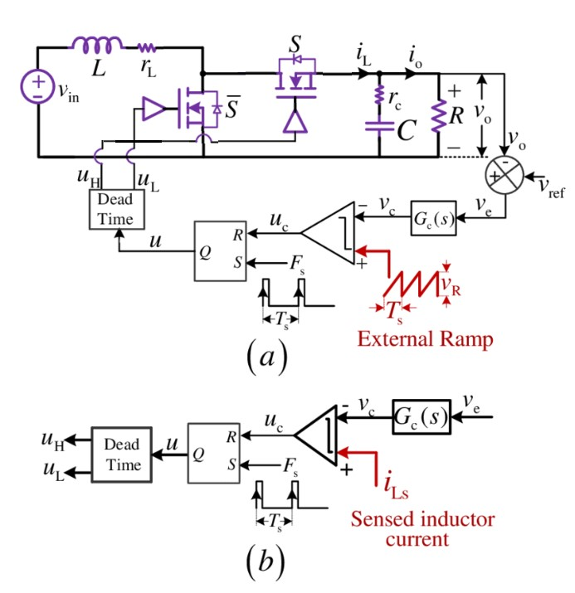
Objectives
Input Supply Voltage (V_{in}) | 0.3 – 0.8 | V
Output Voltage | 1.1 | V
Output Ripple | <40 | mV
Maximum Efficiency (@ V_{in} = 300mV) | 39 | %
Start-up time | < 1 | s
Start-up voltage | 300 | mV
Boost Converter
Achieving regulated boost output voltage of 1.1 V

Slide 3
Methodology
Compare current output voltage of the boost converter with a fixed reference voltage.
To obtain the necessary duty cycle driving pulse, take the error voltage and compare it to the ramp voltage.
Create two pulse signals with a delay between them using the DeadTime generator.
Forward those pulse signal to respective MOSFET gate.

Slide 4
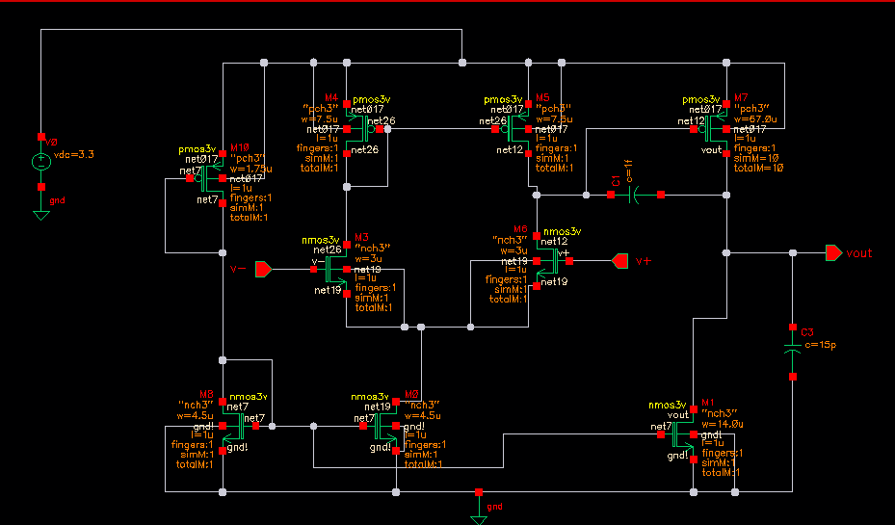
Opamp schematic

Slide 5
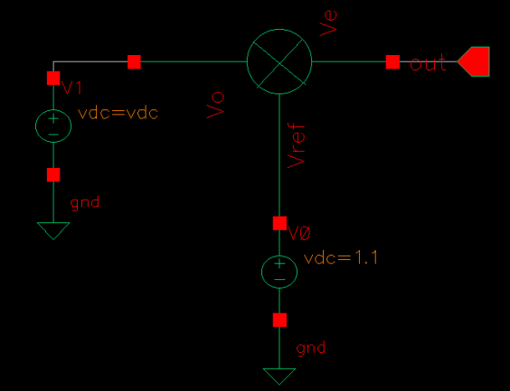
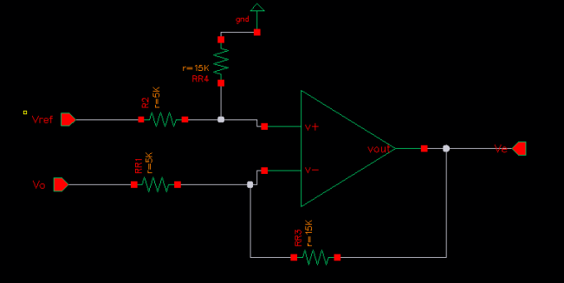
Error Amplifier
Amplify the generated error signal by subtracting the output voltage from reference voltage

Slide 6
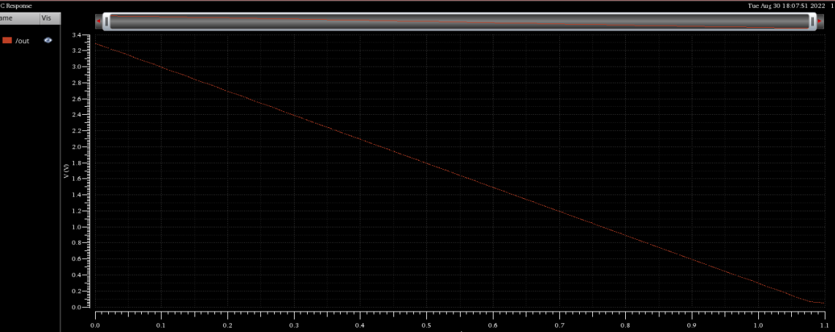
Verification of error Amplifier
Vref=1.1 V
Gain of differential op amp =3
Vo along x-axis
Ve=R3(Vref-Vo)/R1

Slide 7
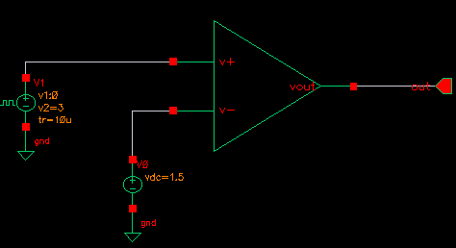
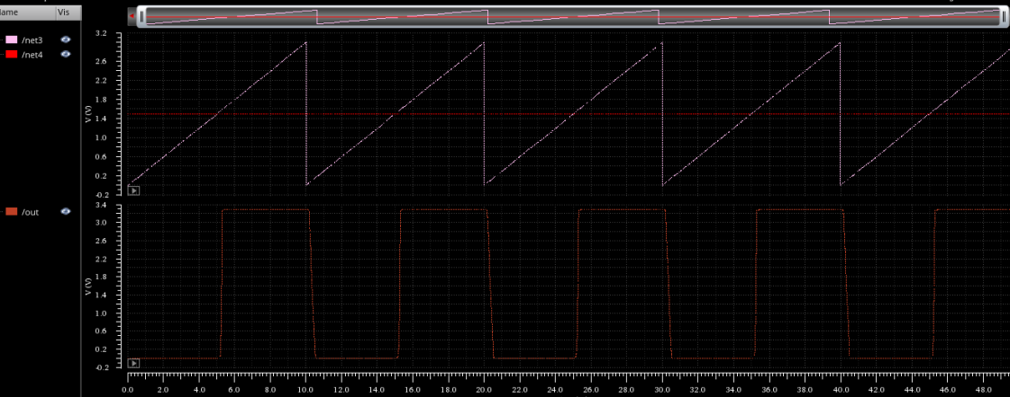
Comparator
Error(Ve) is compared with a sawtooth(Vc) signal
If Vc>Ve, output is high else low

Slide 8
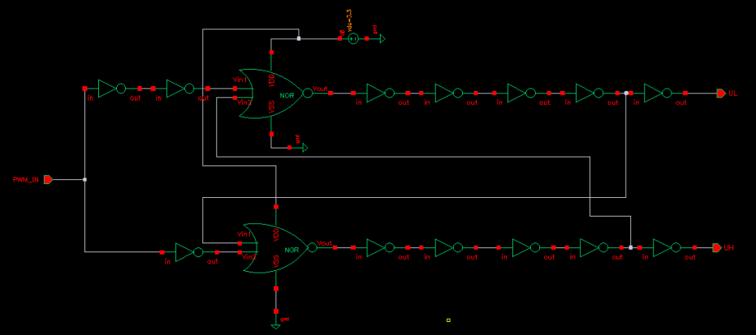
Dead Time Generator
Two pulses with a small delay with inverted pulses.

Slide 9
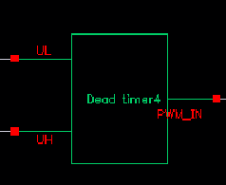
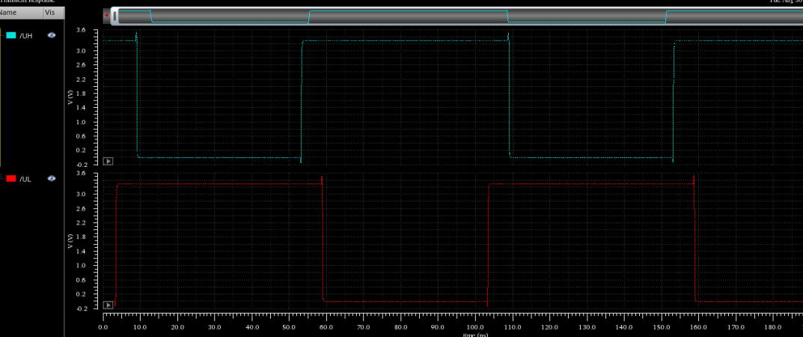
Output of Dead Time Generator

Slide 10
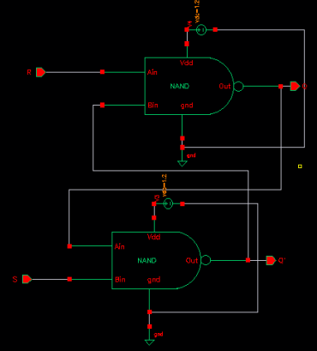
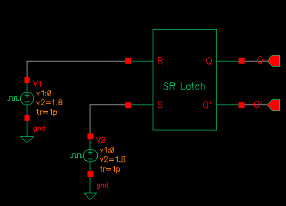
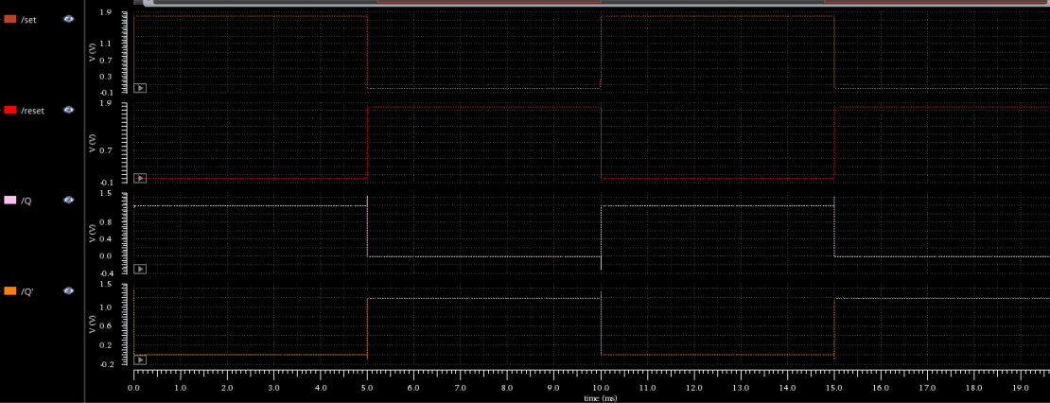
SR Latch

Slide 11
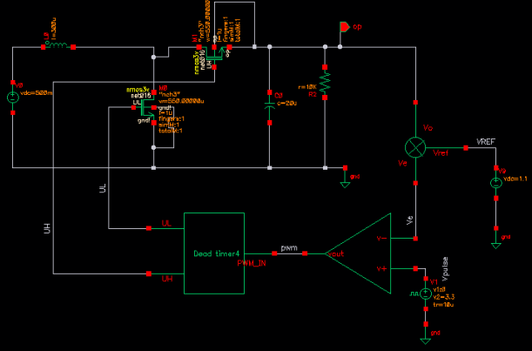
BOOST Circuit
Inductance and capacitance of our circuit is chosen accordingly to stabilize the output

Slide 12
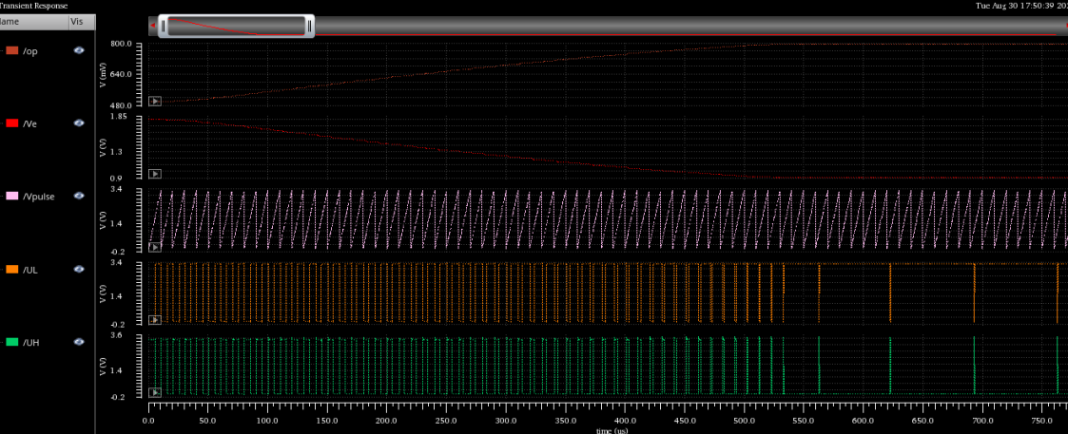
Final Simulation

Slide 13
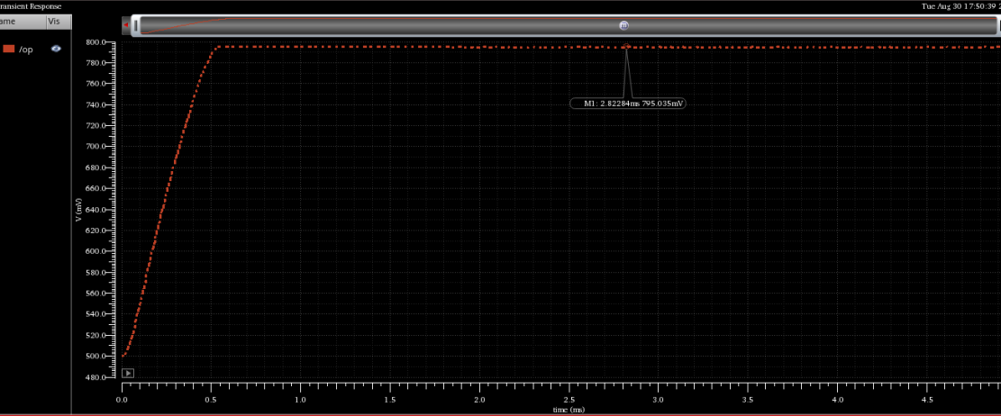
Input Supply Voltage (V_{in}) | 0.3 | V
Output Voltage | 0.8 | V
Output Ripple | <5 | mV
Efficiency (@ V_{in} = 300mV) | 22 | %
Start-up time | < 1 | s
Start-up voltage | 500 | mV

Slide 14
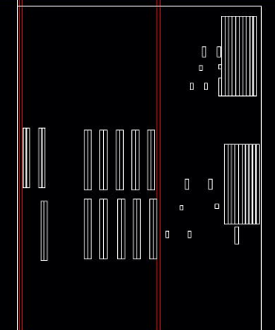
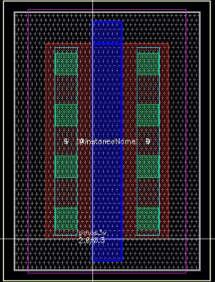
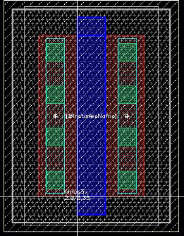
Generated Layout
Full
NMOS
PMOS

Slide 15


